Slide 1
Using Libraries
(aka, using other people’s code)
(aka, using code in other packages)
(aka, using packages)
Notes:
https://golang.org/doc/code.html#Library
then
testing

Slide 2
naming & organizing
files and packages

Slide 3
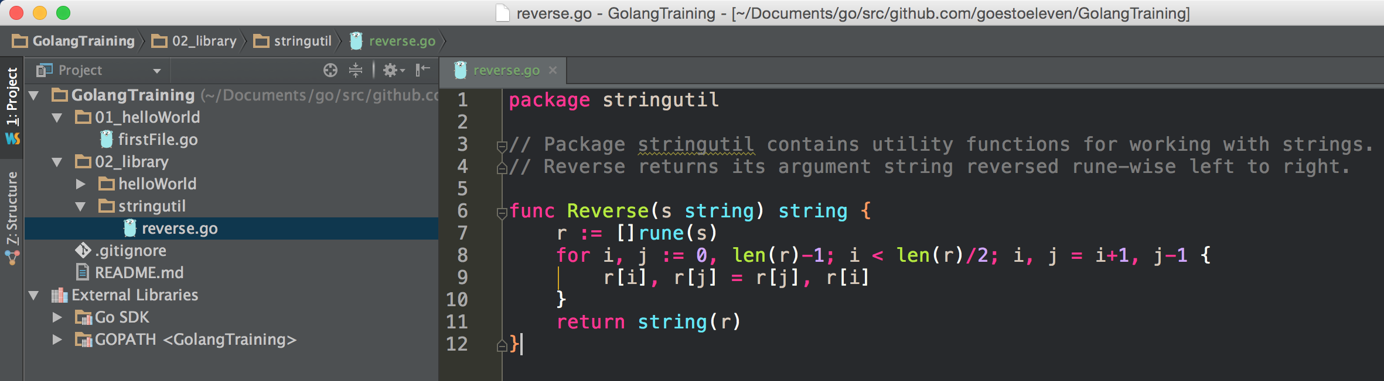
Package name must match containing folder name …

Slide 4
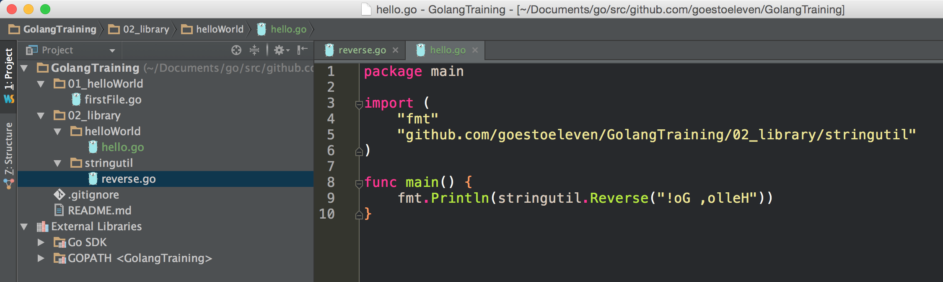
… unless the package is main
Reminder: There can only be one main function per executable program.
You can have other functions in the main package.

Slide 5
File names: short, evocative, concise, error on the side of brevity.

Slide 6
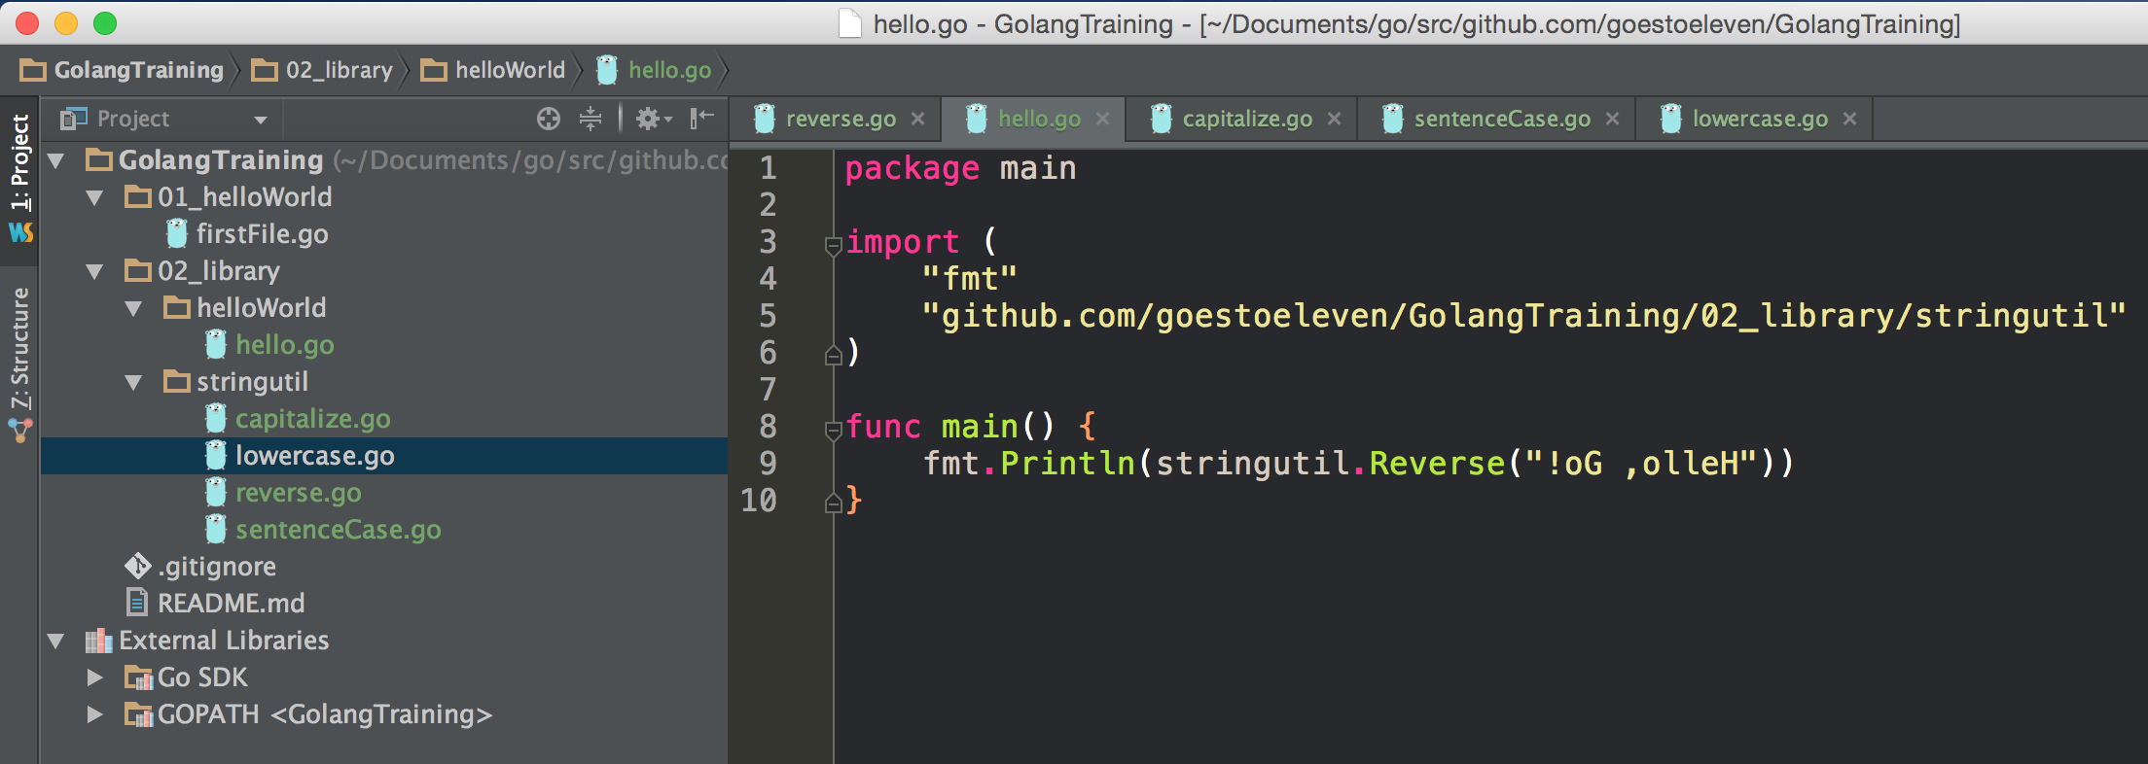
You can have as many files
as you’d like in a package

Slide 7
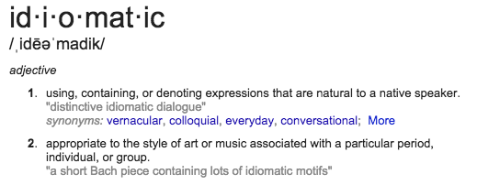
By the way, FYI
Notice the folder structure:
02_library is not idiomatic go
I’m using this non-idiomatic structure to keep these files in sequence

Slide 8
capitalization
Public / private
(capitalized) / (camelCase)
applies to functions, variables, and types

Slide 9
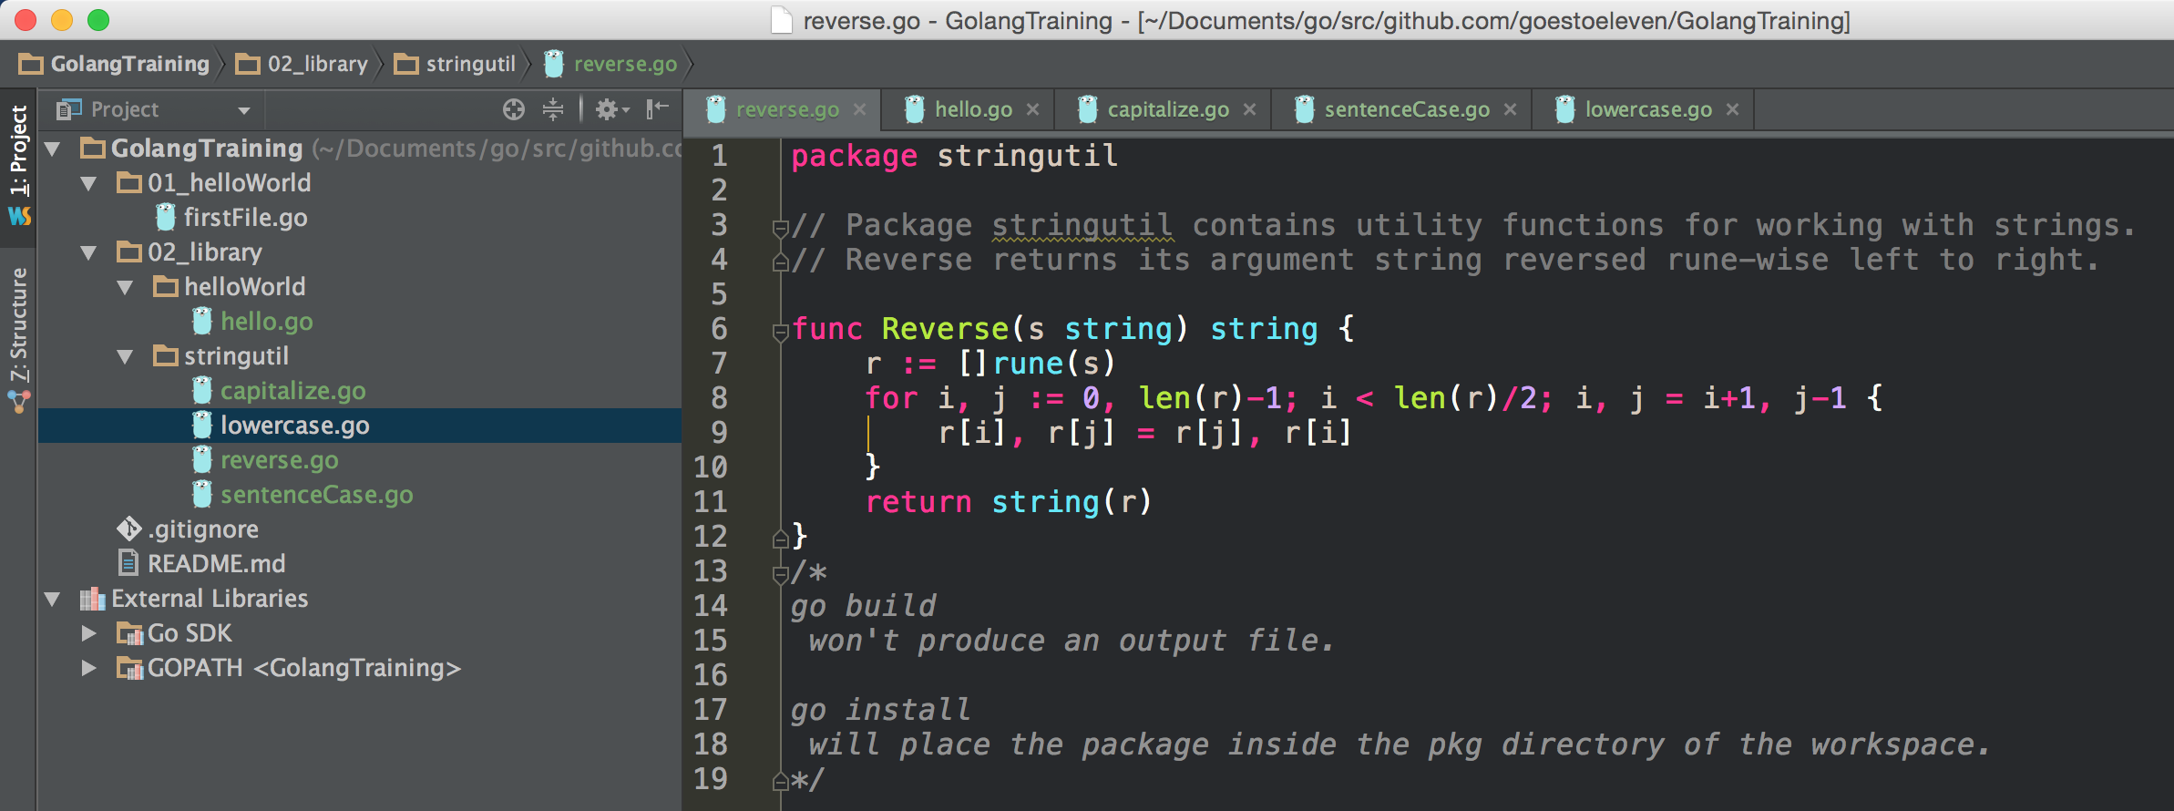
Reminder:
For a function to be available outside a package, the function name must be uppercase

Slide 10
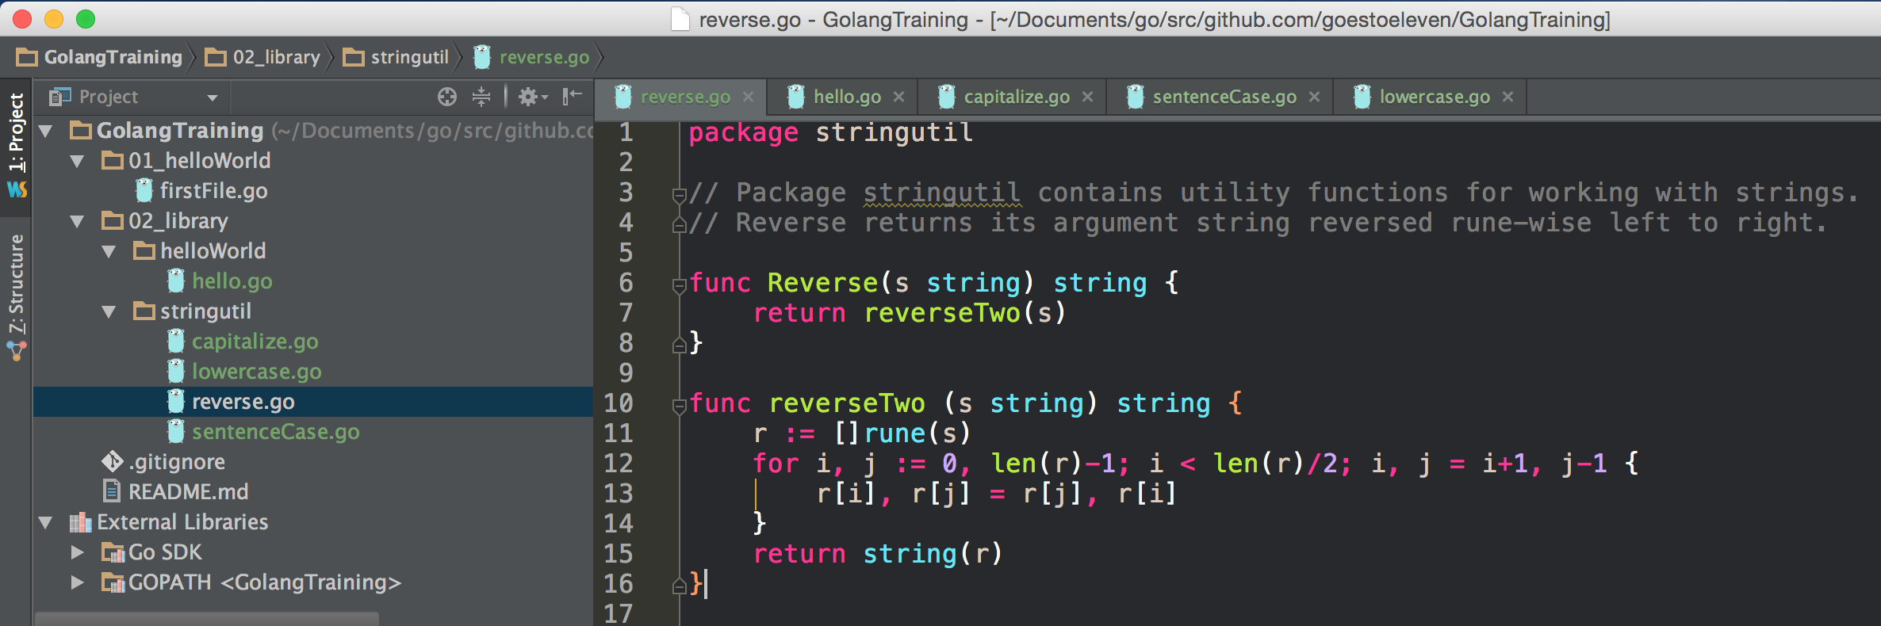
Reminder:
For a function to be available outside a package, the function name must be uppercase
reverseTwo is available inside the package ...

Slide 11
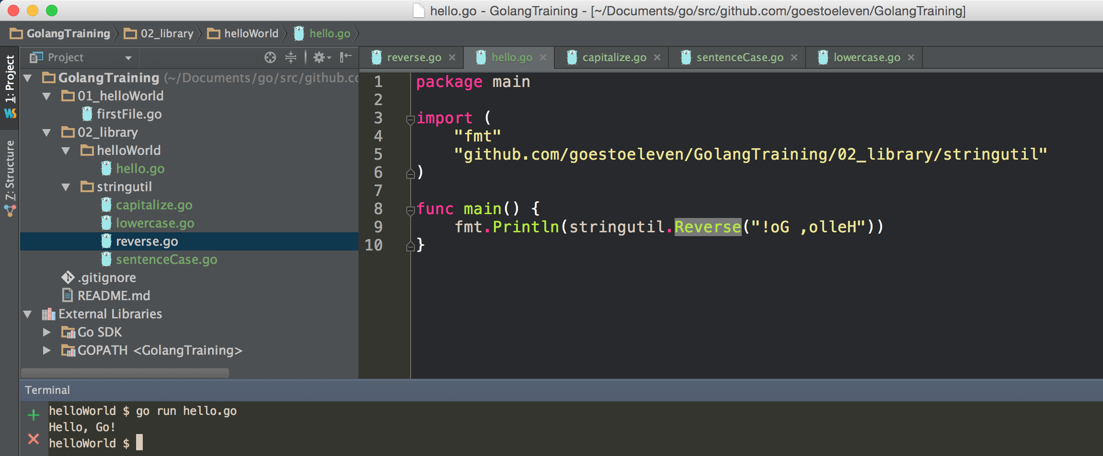
Reminder:
For a function to be available outside a package, the function name must be uppercase
code runs

Slide 12
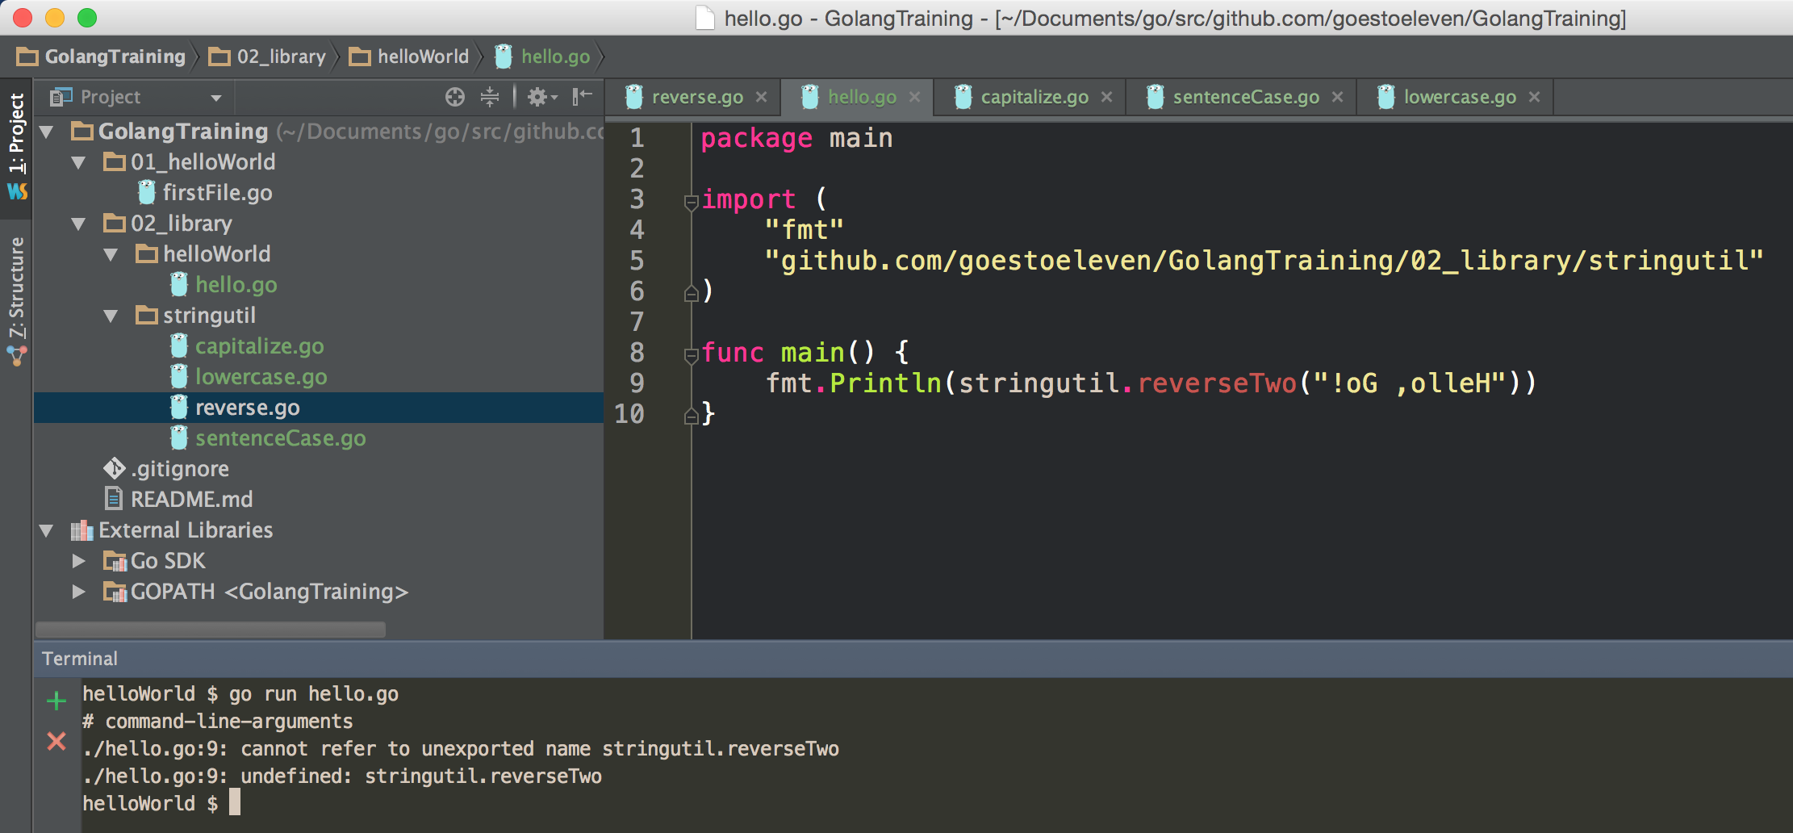
Reminder:
For a function to be available outside a package, the function name must be uppercase
reverseTwo is available inside the stringutil package … but not outside the package.
code doesn’t run

Slide 13
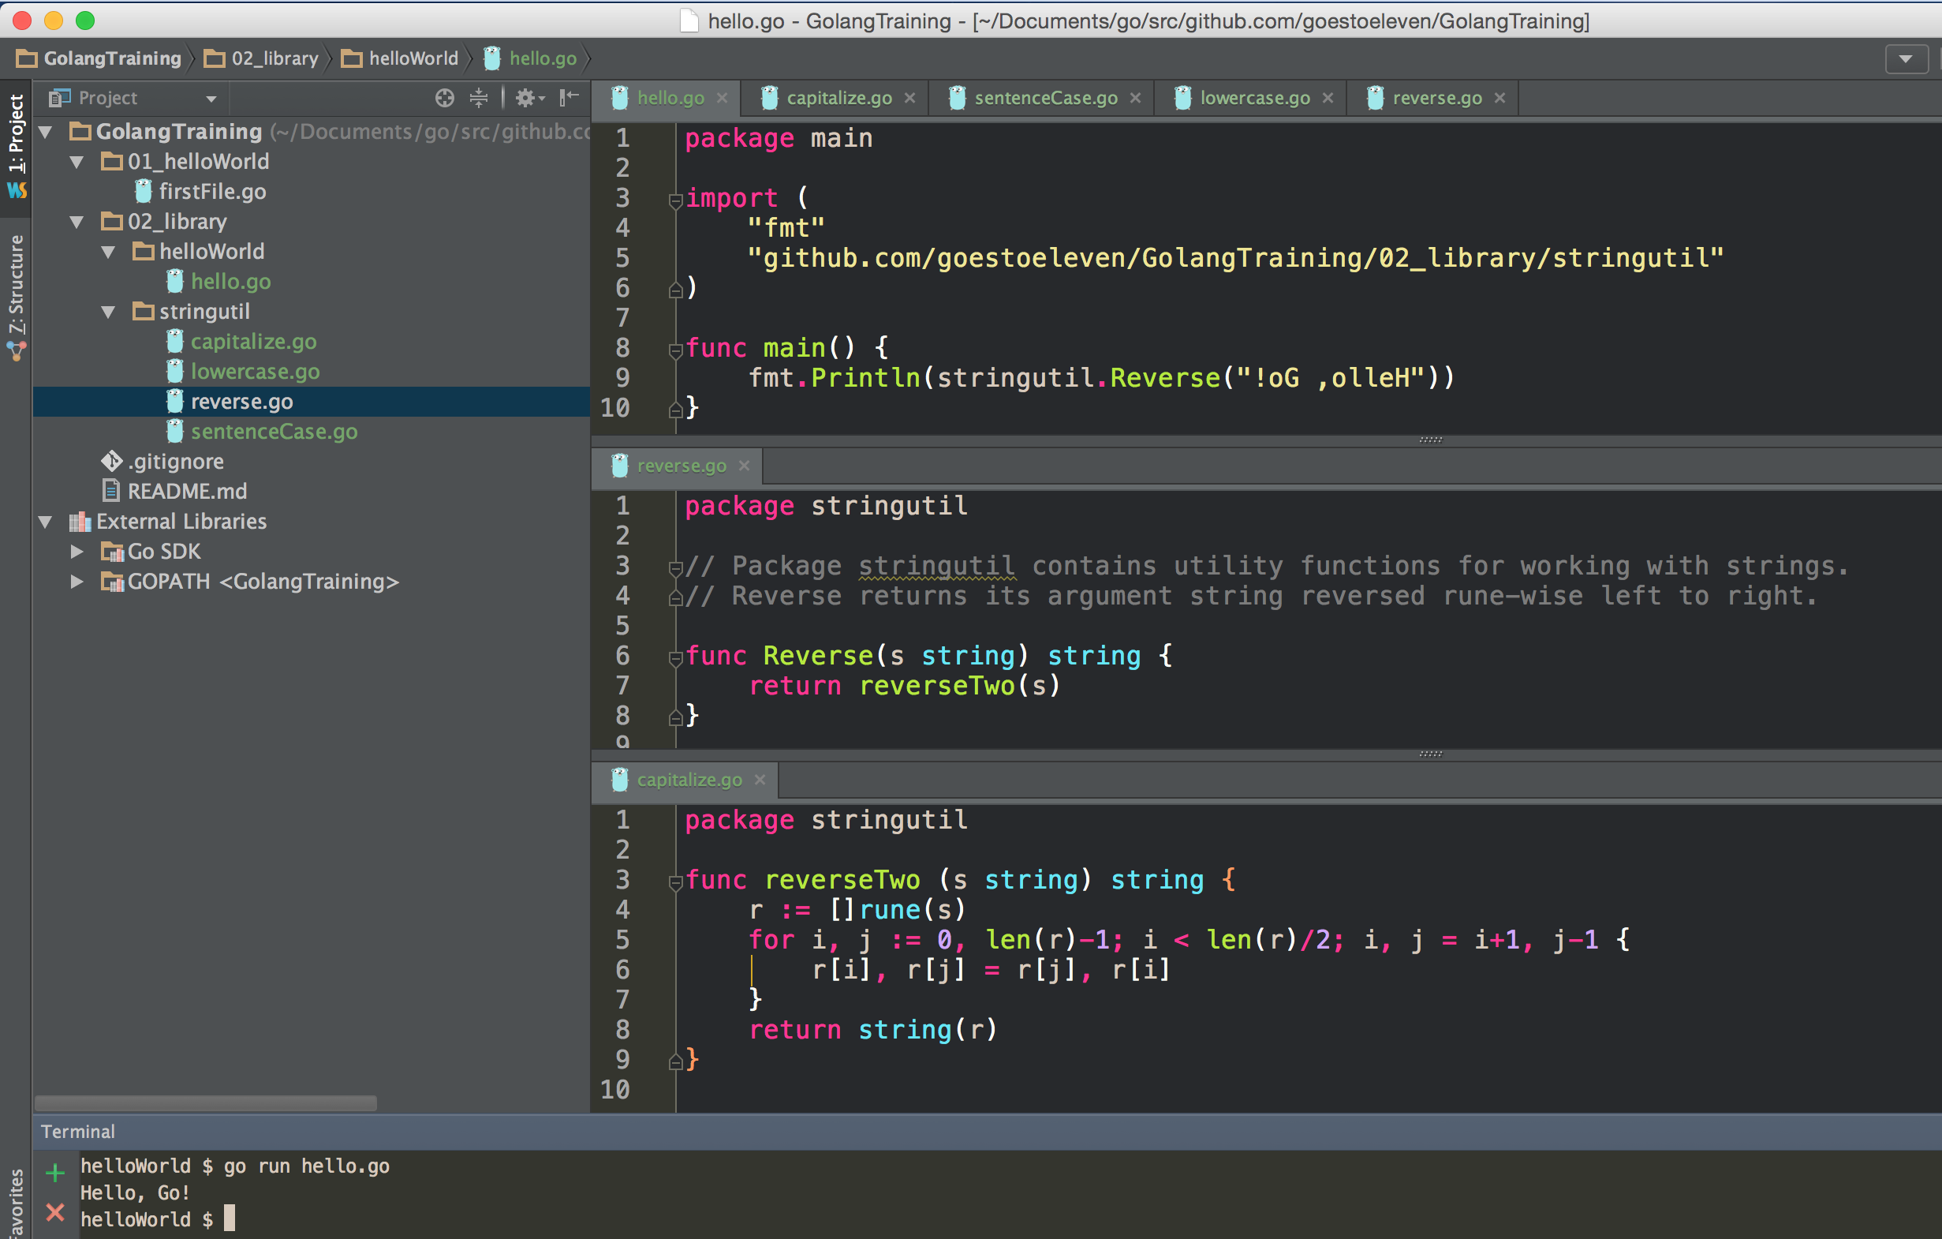
what is this demonstrating?
Notes:
private functions are available anywhere in a function regardless of which file the function is in.

Slide 14
Public function
not public function
what is this demonstrating?
Notes:
private functions are available anywhere in a function regardless of which file the function is in.

Slide 15
go fmt
formats your code
nice article on go fmt

Slide 16
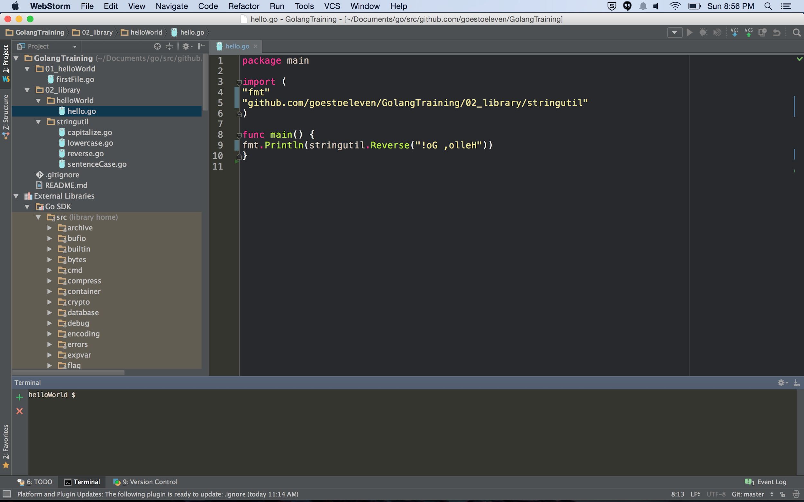
My code is not formatted in as idiomatic code.

Slide 17
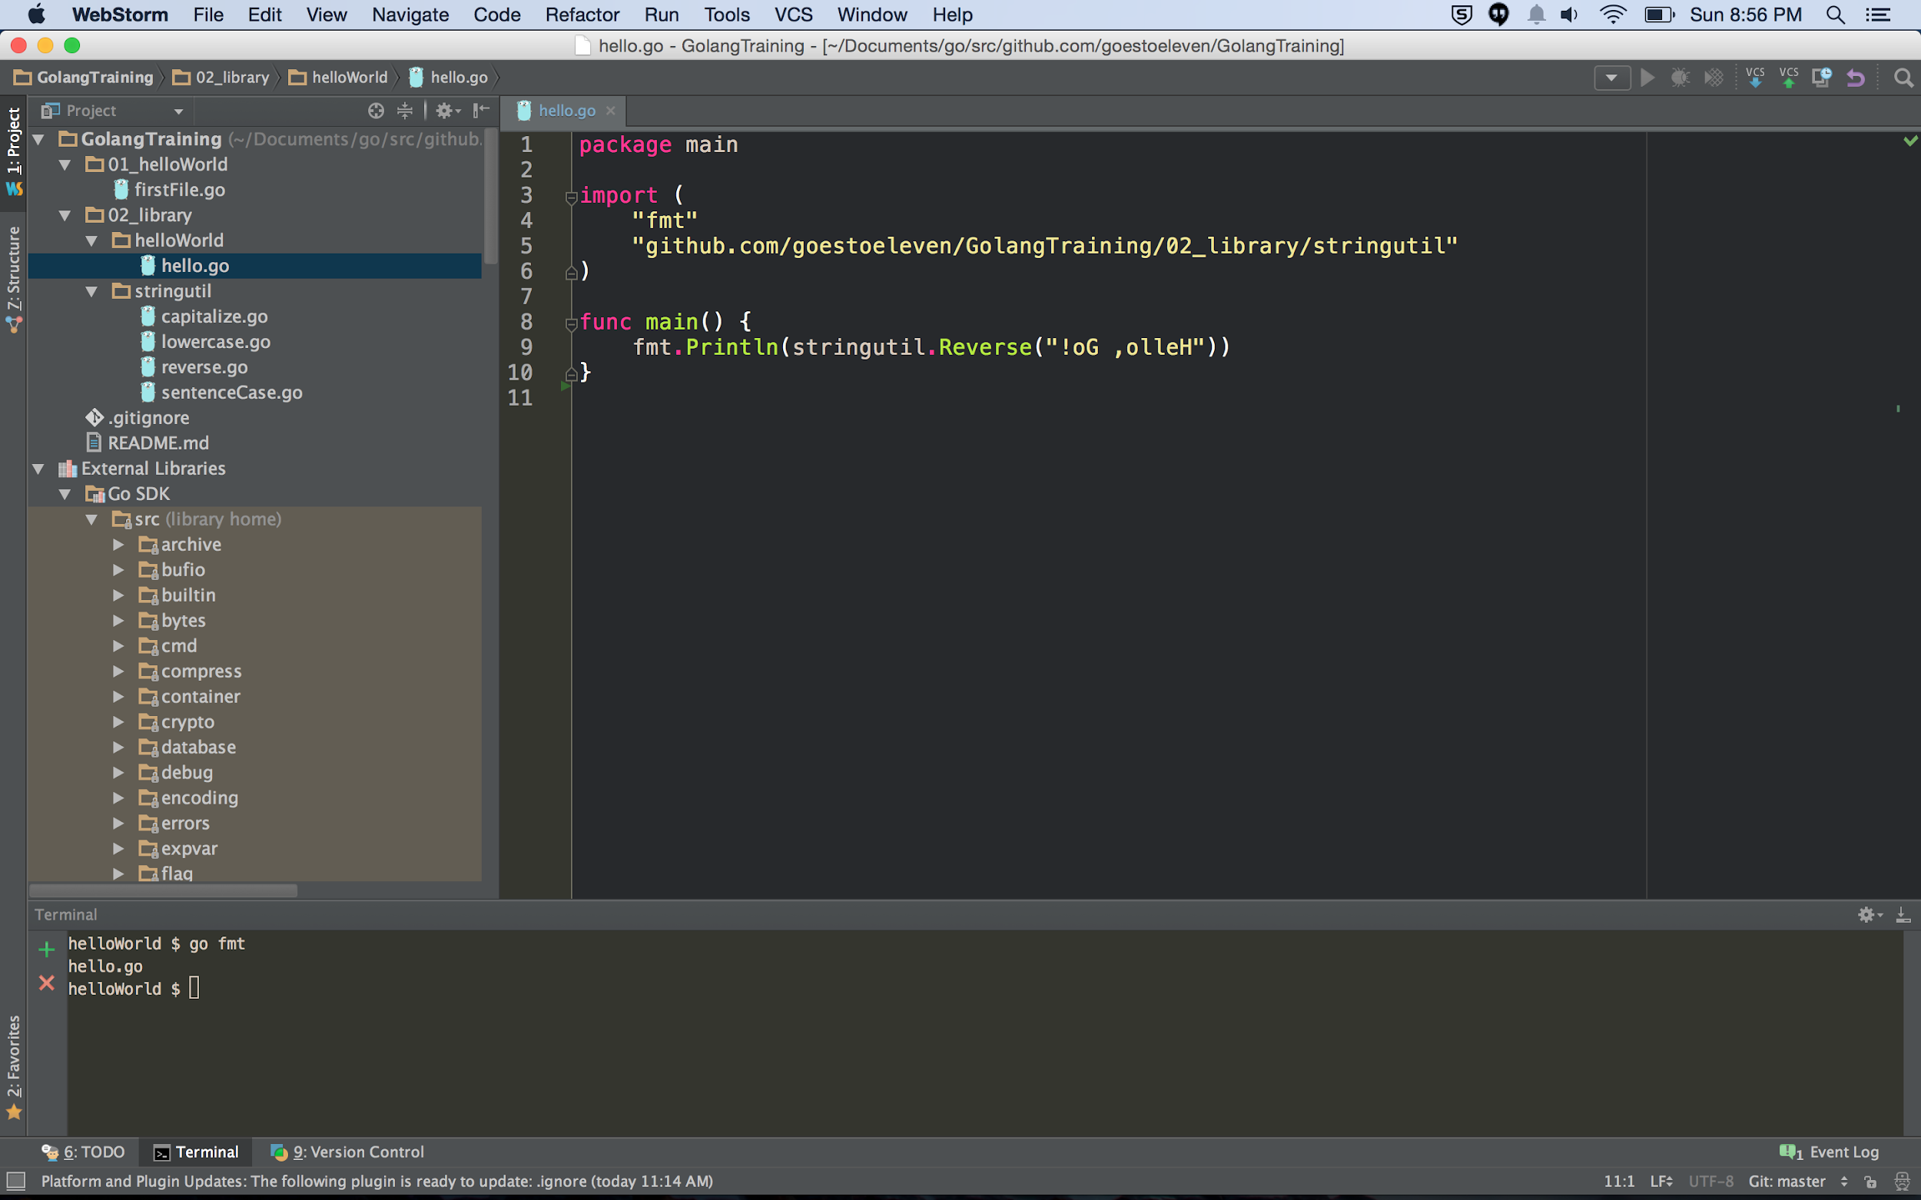
My code is formatted in as idiomatic code.

Slide 18
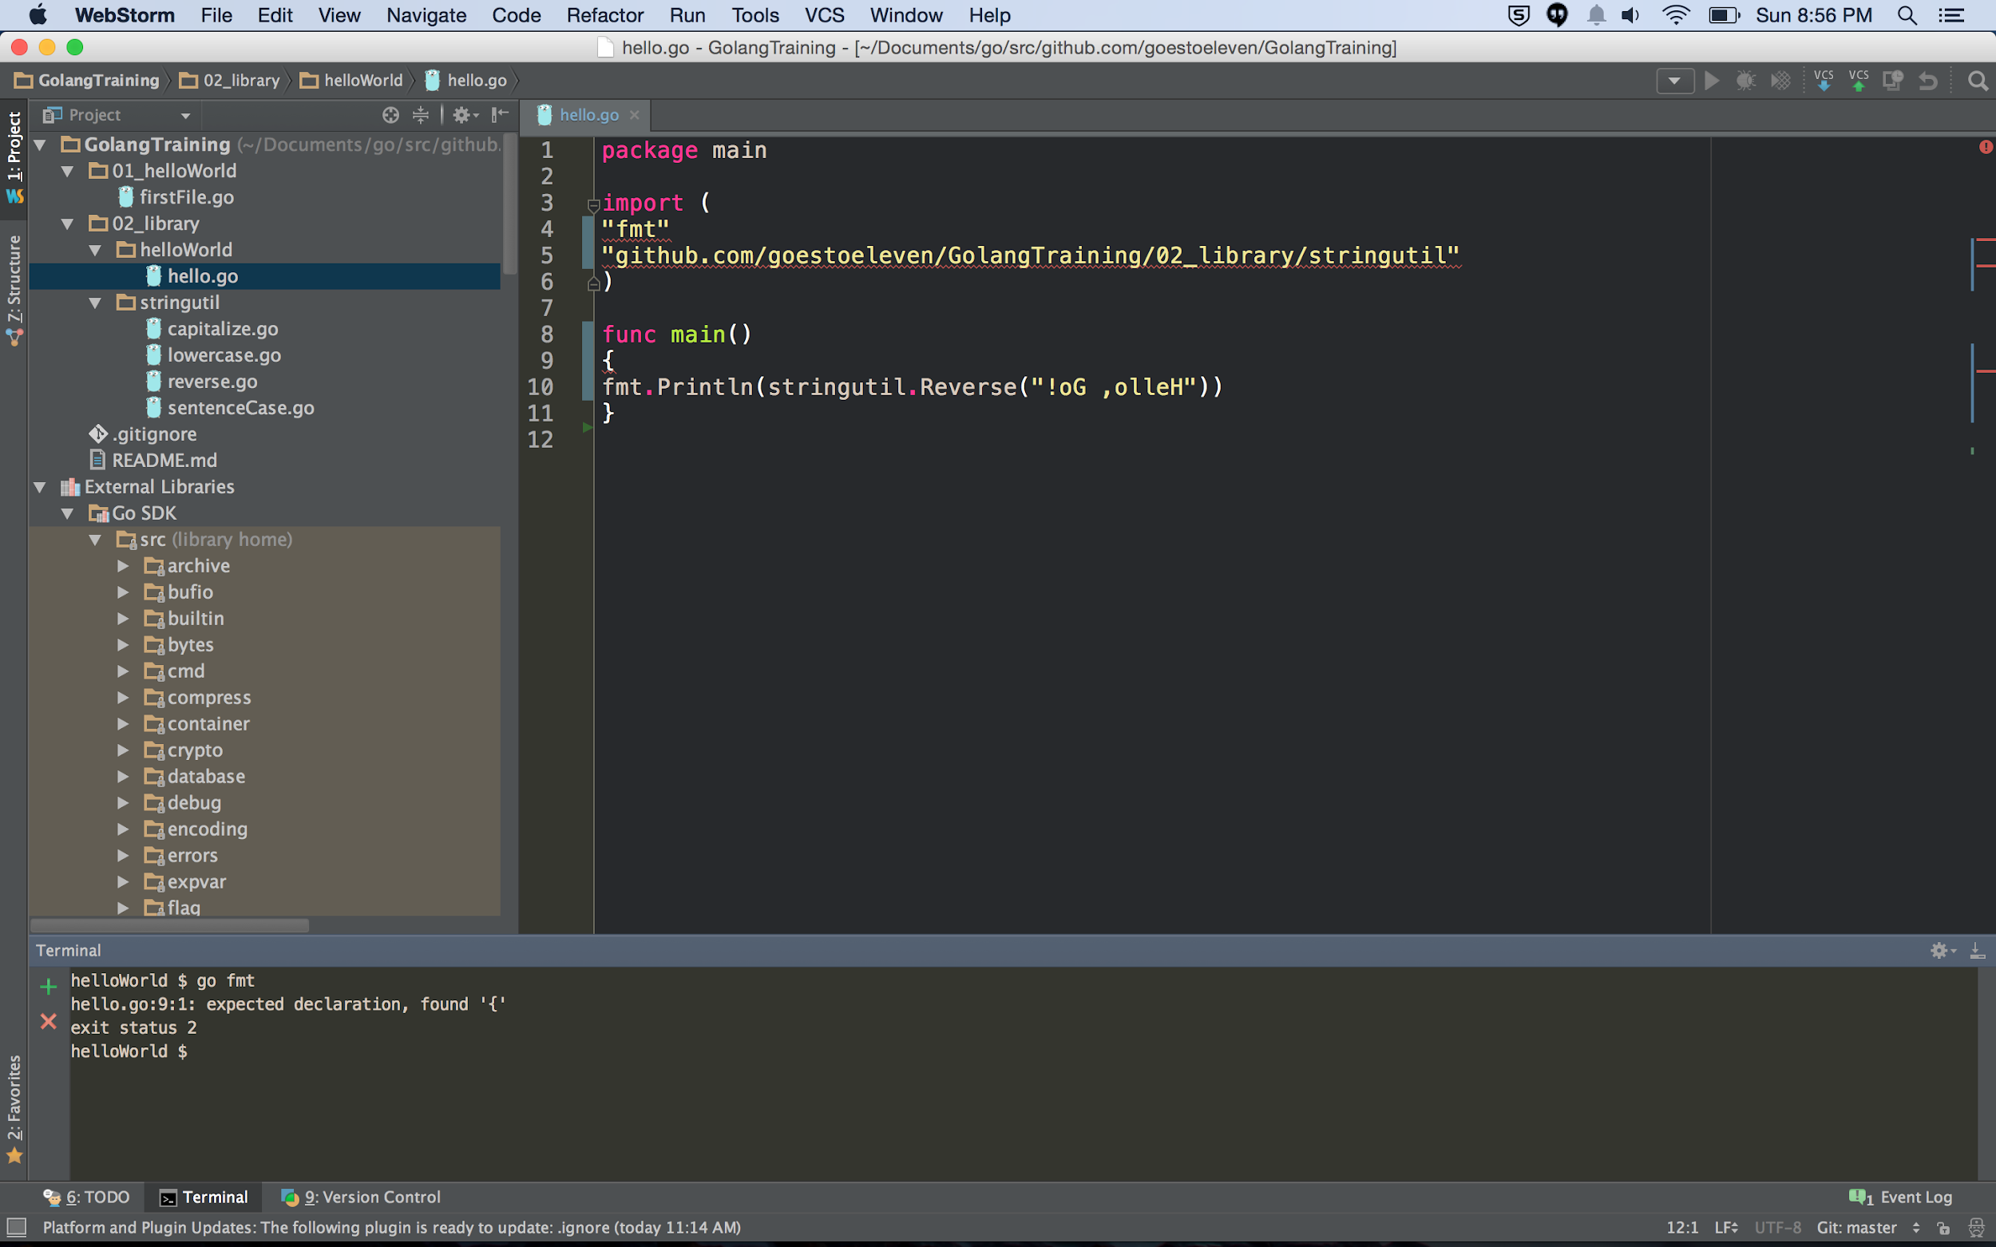
Semicolons are automatically inserted by the compiler.
Your curly braces can’t be like the code above.

Slide 19
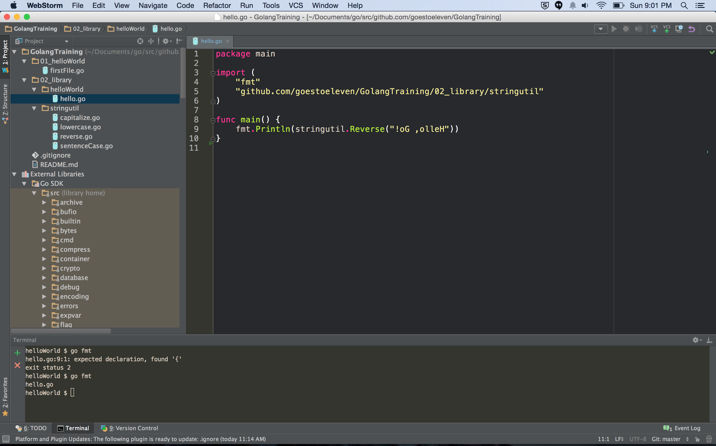
Semicolons are automatically inserted by the compiler.
Now my curly braces are correct

Slide 20
Review
package name must match folder name
except for package main
package main
must have func main() {}
can contain other functions also
packages can be organized into any number of files
capitalization
Public
private
camelCase
go fmt

Slide 21
Review Questions

Slide 22
package main
Does package main have to be in a folder called main?

Slide 23
package main
Does package main have to have a func called main?

Slide 24
camelCase
True or False:
idiomatic go uses camelCase.

Slide 25
go fmt
Write “hello go” again, indenting your code all of the way to the left
take a screenshot of this
run go fmt at the terminal
take a screenshot of this

